Slide 1
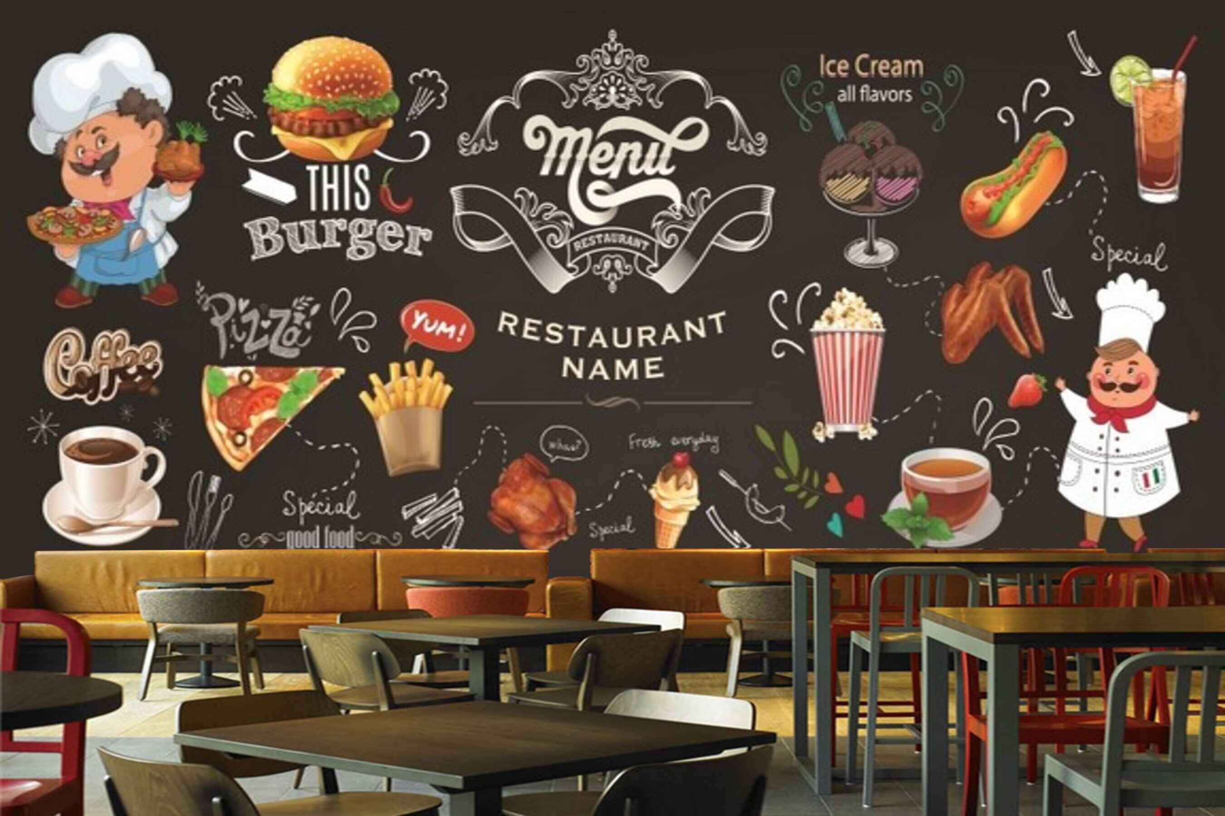
Problem Statement
We have the sales data of a restaurant of the last 15 days. It consists of details on the time of customer visit, type of orders, the amount spent against the orders by the customers, etc.
The restaurant provides a variety of menus.
However, the management wants to take action on cost-cutting and improving the profit.
Analyse the data and help them by providing actionable insights with the visual representation of data analysis to justify your suggestions.

Slide 2
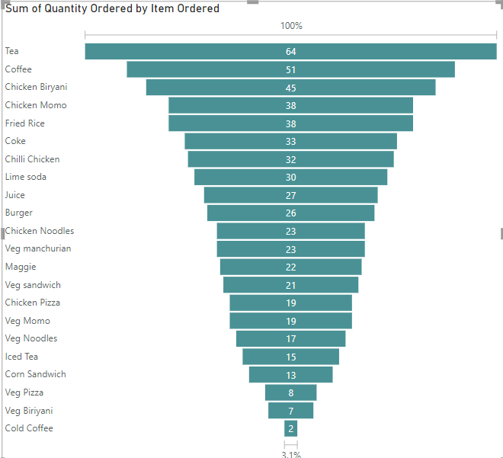
:Which item is sold the most and which item is sold the least:
Here All Items Has Specific Price Range of the Restaurent
The data contains two columns: "Item Ordered" and "Sum of Quantity Ordered," which represent the items and the total number of each item sold
I'll find the maximum and minimum values from the "Sum of Quantity Ordered" column.
The most sold item is Tea, with a total of 64 units ordered. The least sold item is Cold Coffee, with only 2 units ordered
Based on the sales data provided, Tea is the most popular item on the menu, indicating strong customer preference for it. On the other hand, Cold Coffee is the least popular item, suggesting lower demand

Slide 3
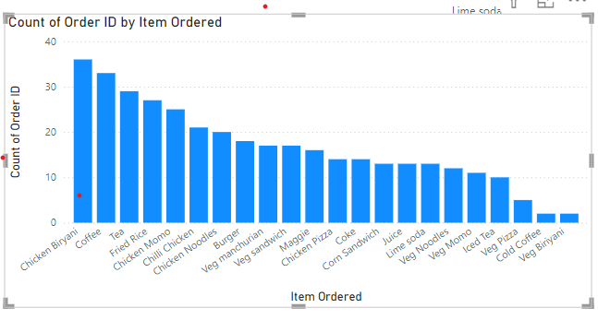
The provided bar chart shows the count of order IDs for different items ordered. Based on this visualization, we can gain the following insights
The height of each bar represents the number of times an item was ordered. Therefore, the chart visually indicates the most popular items among customers. In this case, Chicken Biryani and Coffee appear to be the most frequently ordered items
Items with shorter bars represent those that were ordered less frequently. Veg Biriyani and Cold Coffee seem to be among the least popular items.
The chart allows for a comparison of the popularity of different items. For example, Chicken Momo is more popular than Veg Momo, and Tea is more popular than Iced Tea
These insights can be valuable for making informed decisions about the menu, marketing efforts, and inventory management
By understanding the popularity of different items, the business can focus on promoting and offering those that are most in demand, while considering adjusting the availability or pricing of less popular items.

Slide 4
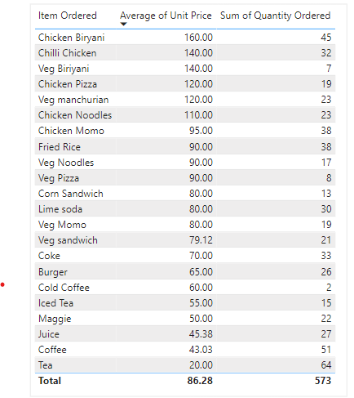
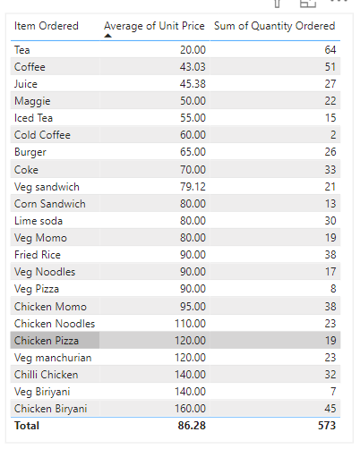
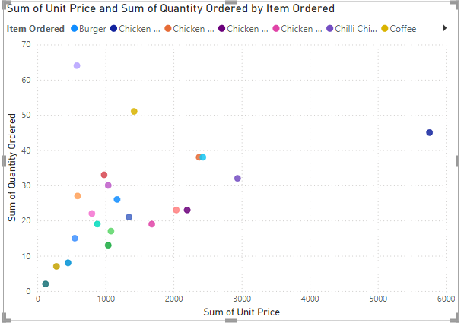
Are more units ordered against lower-priced items or higher-priced items in a single order
There is a weak negative correlation of -0.10 between the price of an item and the quantity ordered. This indicates that, in general, lower-priced items tend to have slightly higher quantities ordered, though the relationship is not very strong
Some lower-priced items, such as Tea (₹20) and Coffee (₹40), are among the most ordered, with 64 and 51 units respectively. Meanwhile, higher-priced items like Chicken Biryani (₹160), Chicken Noodles (110)also have decent sales with 45 units, which suggests exceptions to the general trend.
As per Summary, while lower-priced items tend to be ordered more frequently, higher-priced items can still see significant sales, indicating other factors like preference or meal type might influence ordering patterns.

Slide 5
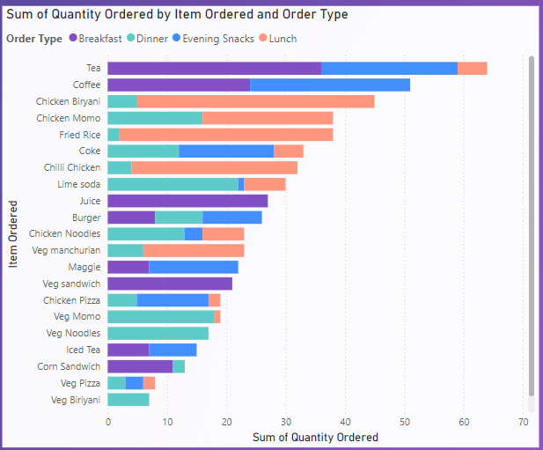
Sale of which items in what type of meal generate a greater amount of sales
The provided waterfall chart shows the sum of quantity ordered for various items across different order types (Breakfast, Dinner, Evening Snacks, and Lunch). Based on this visualization, we can identify the items that generate the greatest amount of sales in each meal type
Breakfast
Tea: Tea is the most popular breakfast item, with a significant portion of the total quantity ordered.
Lunch:
Chicken Biryani:Chicken Biryani is also the most popular lunch item, generating a significant amount of sales.
Evening Snacks:
Chicken Momo: Chicken Momo is the dominant evening snack, accounting for a large portion of the sales in this category
Dinner:
Chicken Biryani: Chicken Biryani appears to be the most popular dinner item, generating a substantial amount of sales.
It's important to note that the specific items and sales quantities may vary depending on the scale and location of the business. However, this analysis provides valuable insights into the popular choices for different meal times

Slide 6
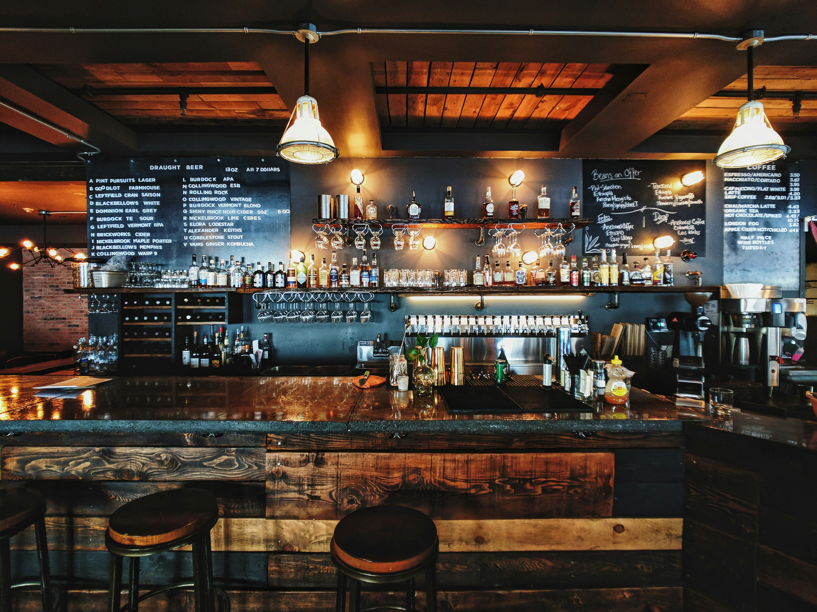
Suggestins offered that company Should continue offering all items at different times of the day or not
Customer Preferences: Consider customer preferences and feedback when deciding which items to offer at different times. For example, if customers often request a late-night snack, consider offering a limited menu of lighter options
Peak Demand Items: Identify the peak times for each item and ensure they are available during those hours. For example, tea and coffee might be in high demand in the morning, while chicken biryani might be more popular for dinner and Lunch.
Preparation Time of each items: Consider the time it takes to prepare each item. Items that require extensive preparation might be better suited for off-peak hours to avoid delays and ensure timely delivery.
:Here's a possible suggestion for offering items at different times of the day:
Morning: Tea, coffee, iced tea, cold coffee, juice, lime soda, coke, veg sandwich, corn sandwich, maggie, burger
Afternoon: Veg Manchurian, chilli chicken, veg noodles, chicken noodles, veg pizza, chicken pizza, veg momo, chicken momo
Evening and Night: Chicken biryani, fried rice
Additional Considerations:
Special Events Purposes: Do Offer special menus or promotions with Discount for holidays or special events (Wedding, Birthday, Receptions, Ceremony, to attract all additional customers.

Slide 7

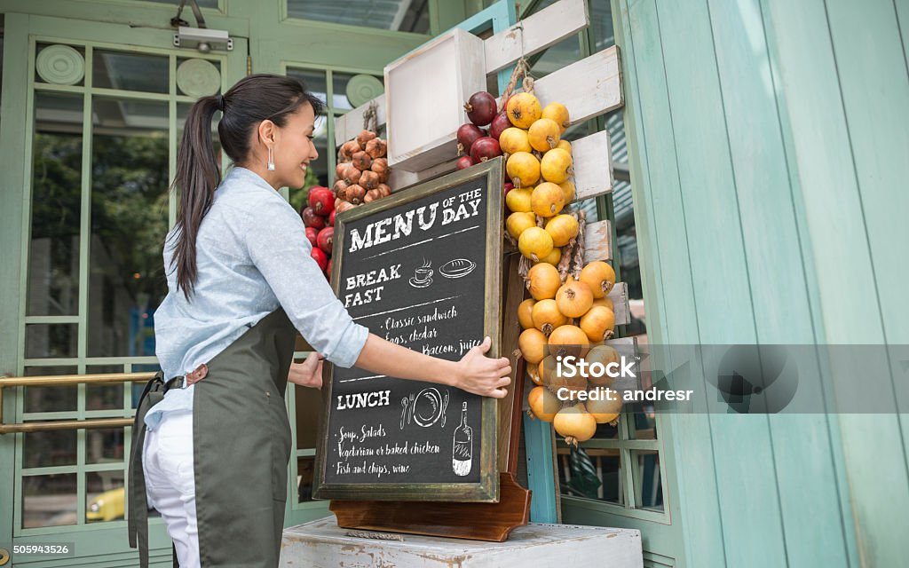
Actionable insights from the analysis for cost-cutting and improving the profit
:Cost-Cutting Insights:
Inventory Management Requirment: Analyze the demand for different items to ensure you have adequate inventory levels without overstocking. Excess inventory can lead to spoilage and increased costs
Negotiate Better Deals with Suppliers:Explore opportunities to negotiate better prices with suppliers for ingredients used in low-profit items. This can help reduce costs and improve margins.
Identify Low-Profit Items: Analyze the items with the lowest quantity ordered, such as Veg Biriyani, Cold Coffee, and Veg Pizza. These items might have low profit margins or be less popular with customers. Consider discontinuing or redesigning them to improve profitability.
:Improving Profit: Focus on marketing and promoting items with high quantity ordered, such as Tea, Coffee, and Chicken Biryani. Create attractive Discounts or bundle them with other popular items to increase sales
Combo Deals Items: Implement strategies to encourage customers to order additional items or higher-priced options. This can be done through suggestive selling or offering combo deals
Utilize Data Analytics Tools: Leverage data analytics tools to gain deeper insights into customer behavior, preferences, and trends. This can help you make more informed decisions.

Slide 8
Thank You

